Slide 1
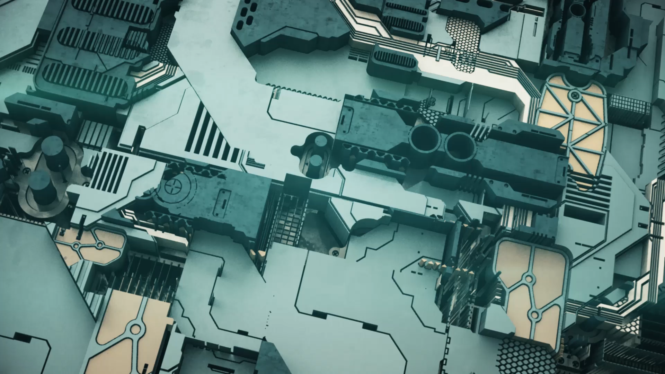
Hardware: Locomotions & Actuators

Slide 2
Hardware Components that move the Robots
1) Stationary Robots
a) Omron forpheus robot
2) Wheeled Robots & Tracked Robots
a) Single wheel BB-8
b) 4WD Omni-Directional Mobile Robot
c) Wall Climbing Robot (Metal vs Wall vs Glass)
3) Legged
a) Humanoid Robot (BIOLOID)
4) Swimming
a) Fish robot
b) Underwater glider robot
5) Others
a) Kilobot

Slide 3
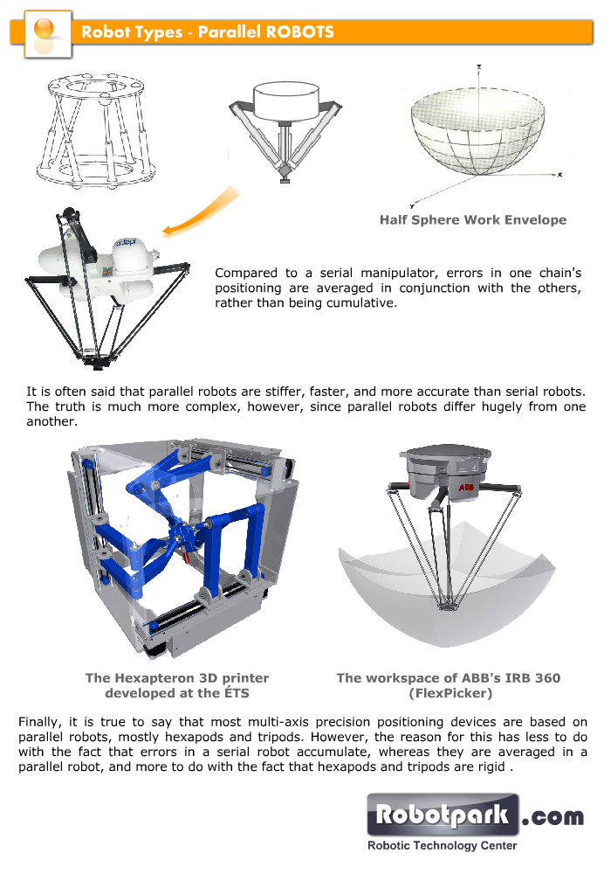
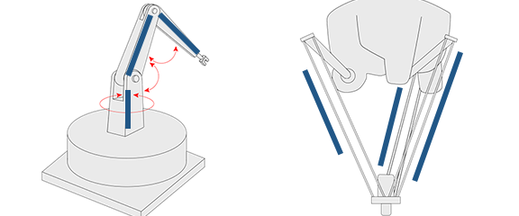
1) Stationary Robots a) Omron Forpheus robot Principle

Slide 4
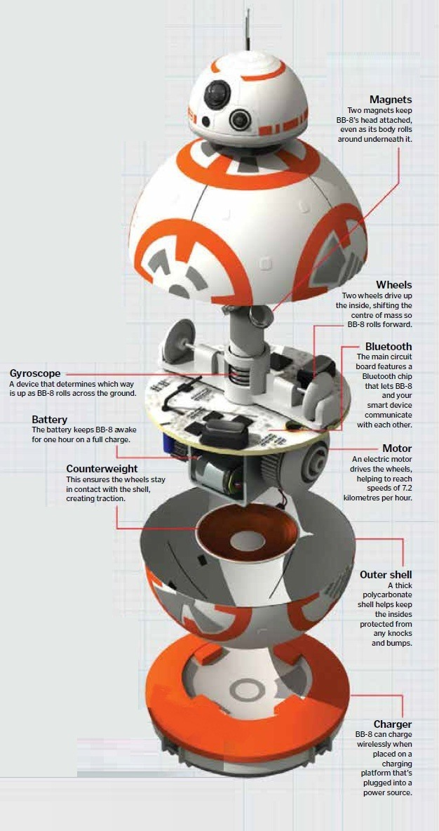
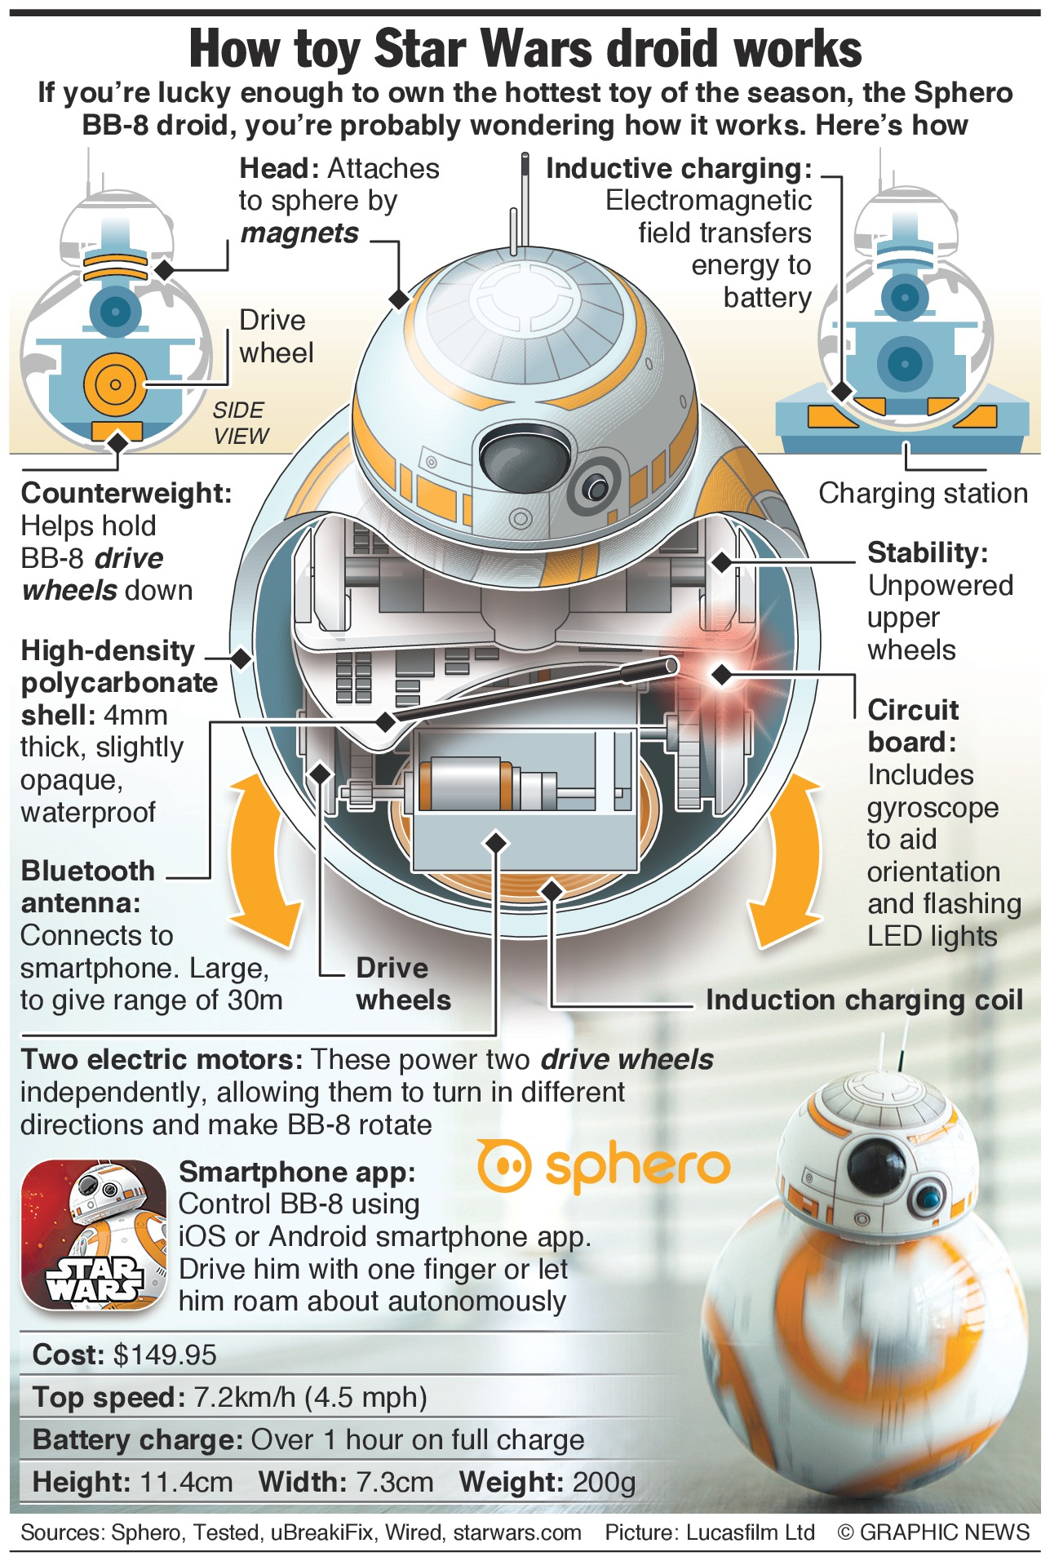
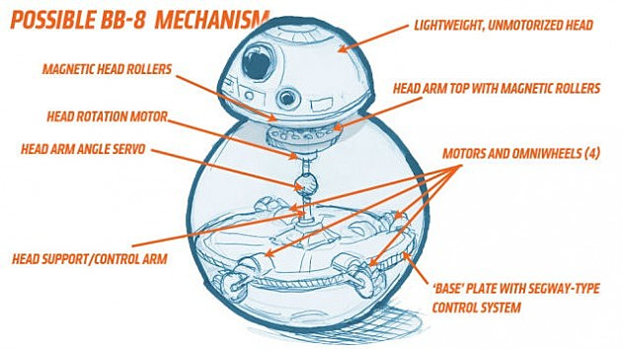
2) Wheeled Robots & Tracked Robots a) Single wheel BB-8

Slide 5
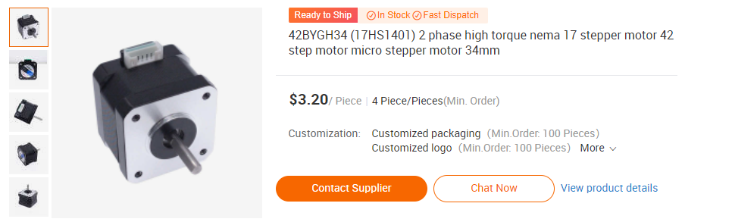
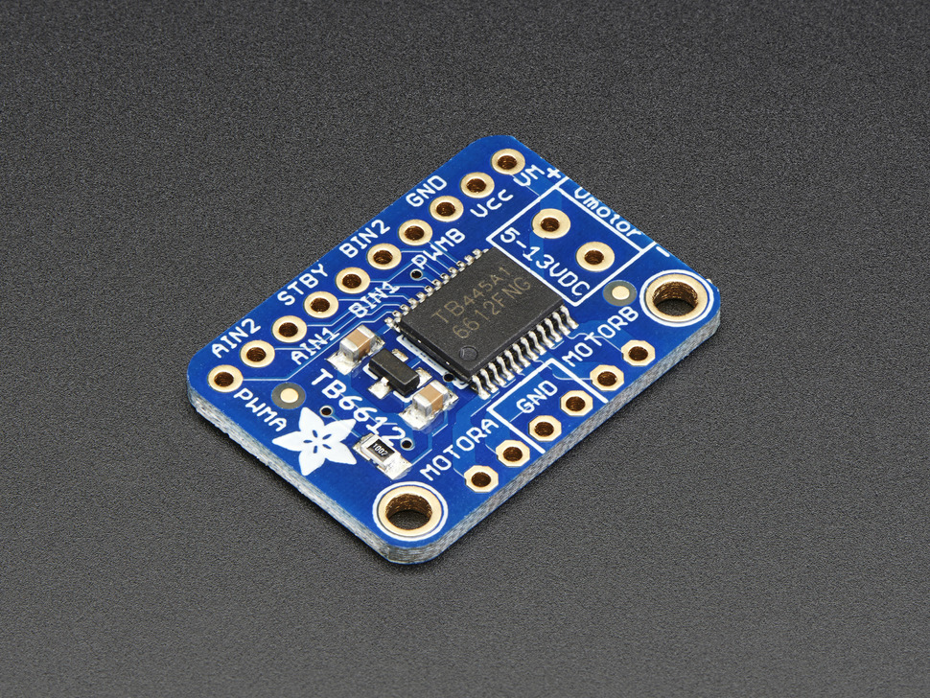
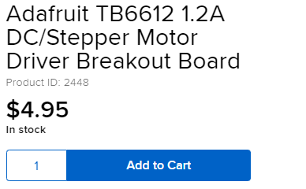
2) Wheeled Robots & Tracked Robots a) Single wheel BB-8 hardware

Slide 6
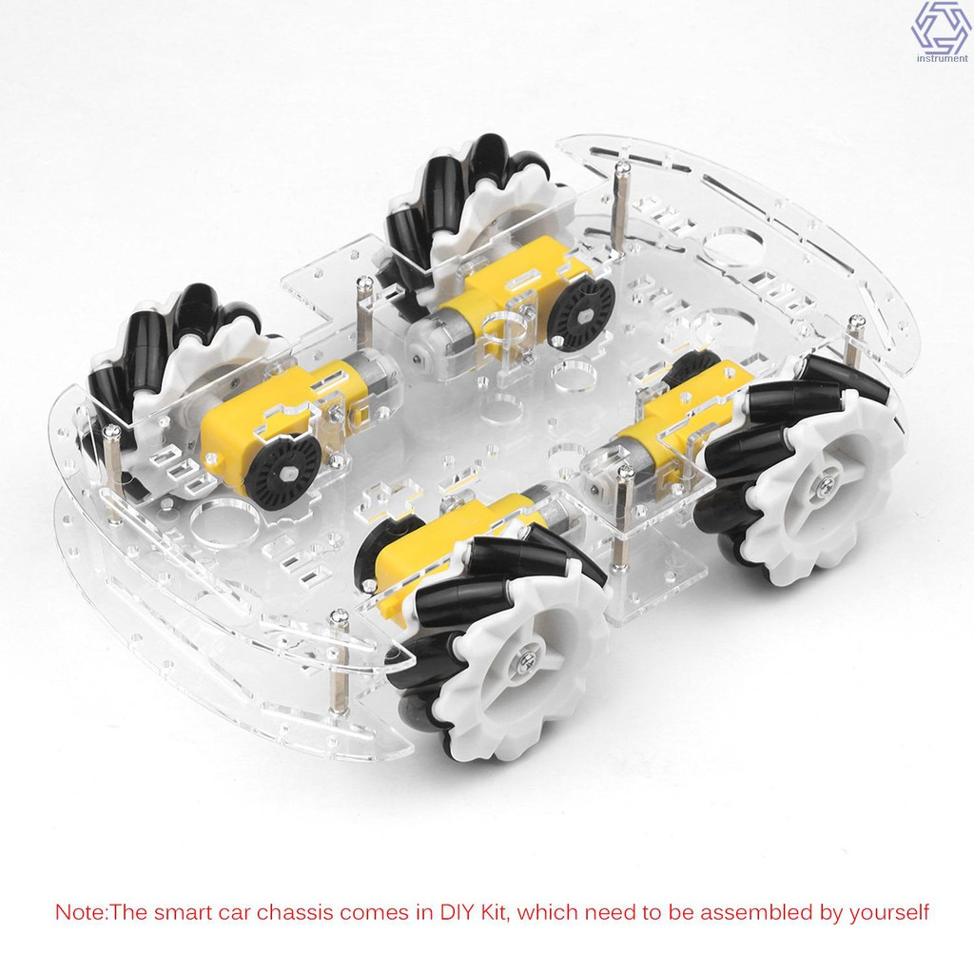
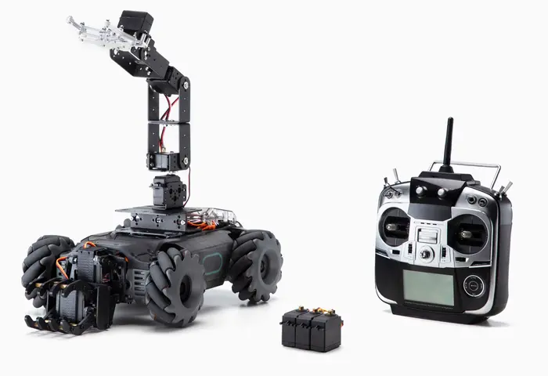
2) Wheeled Robots & Tracked Robots b) 4WD Omni-Directional Mobile Robot

Slide 7
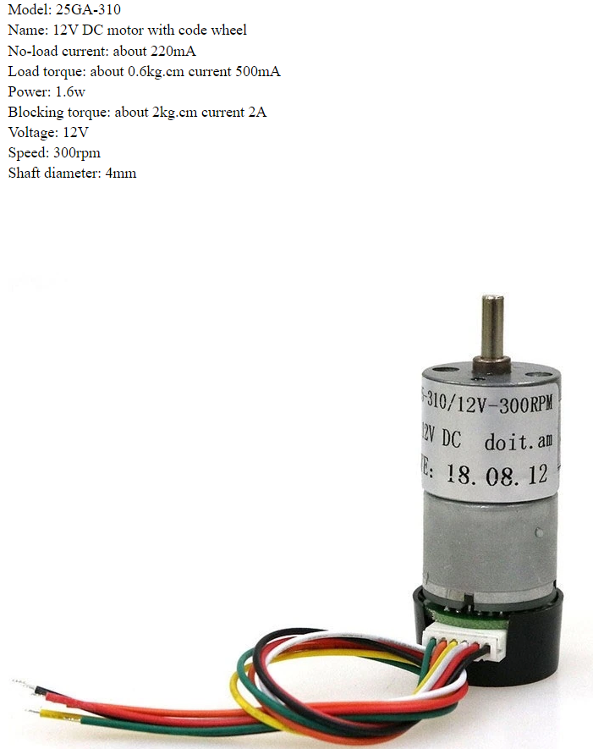
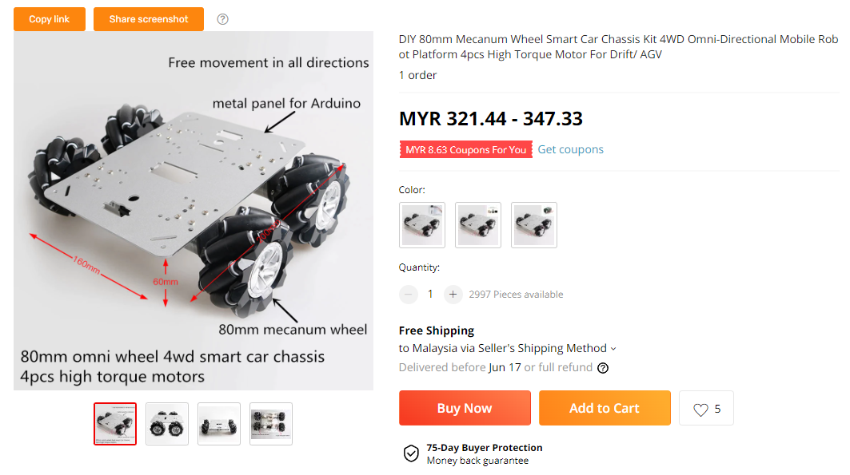
2) Wheeled Robots & Tracked Robots b) 4WD Omni-Directional Mobile Robot

Slide 8
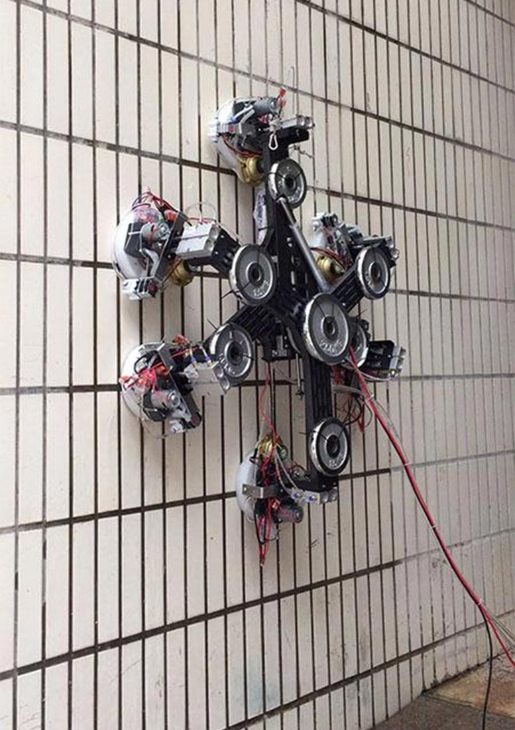
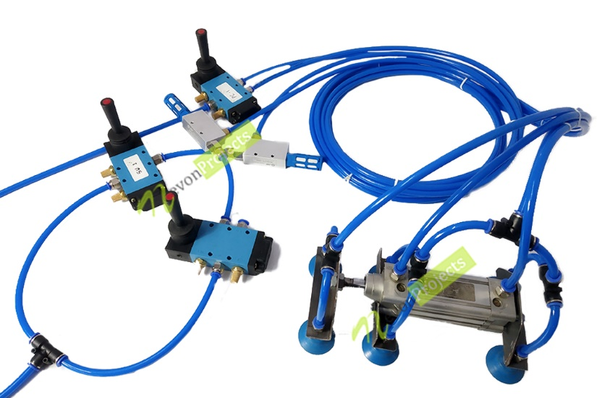
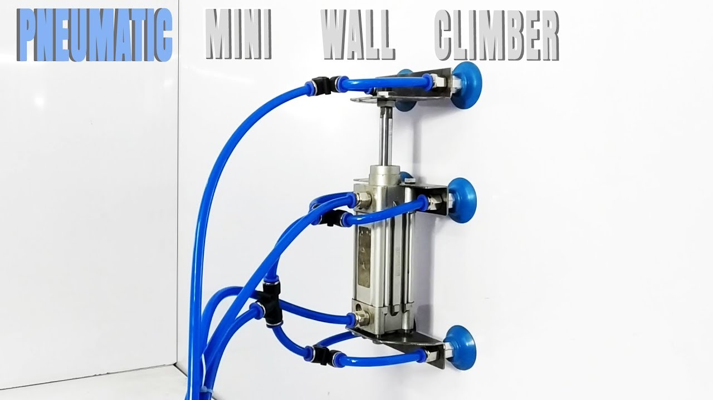
2) Wheeled Robots & Tracked Robots c) Wall Climbing Robot (Metal vs Wall vs Glass)

Slide 9
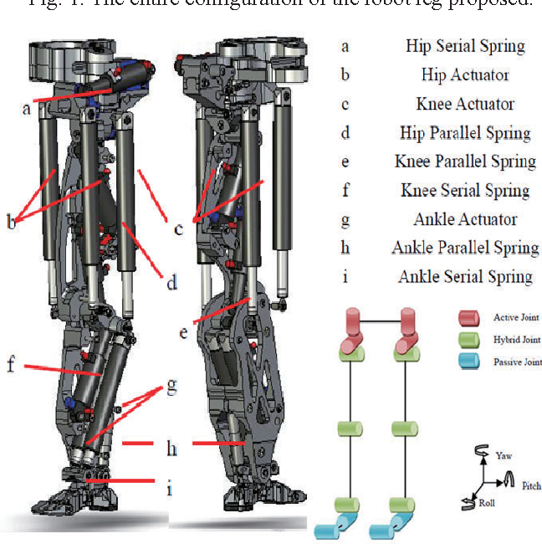
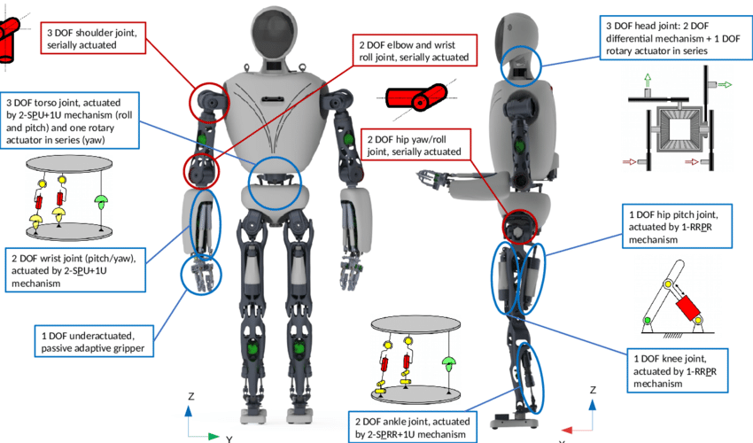
3) Legged - Humanoid Robot (BIOLOID)

Slide 10
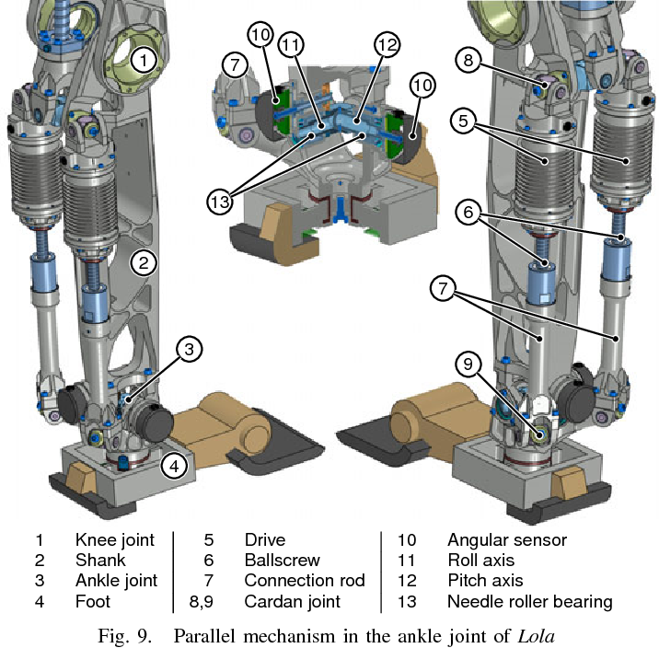
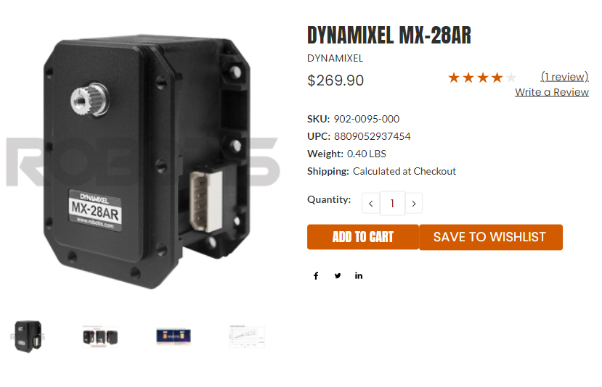
3) Legged a) Humanoid Robot (BIOLOID)

Slide 11
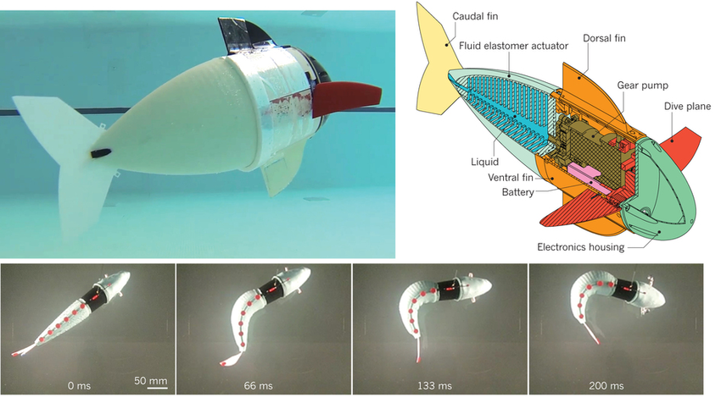
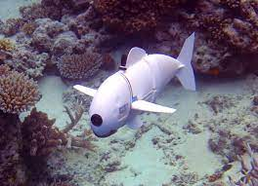
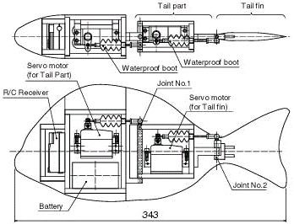
4) Swimming a) Fish robot

Slide 12
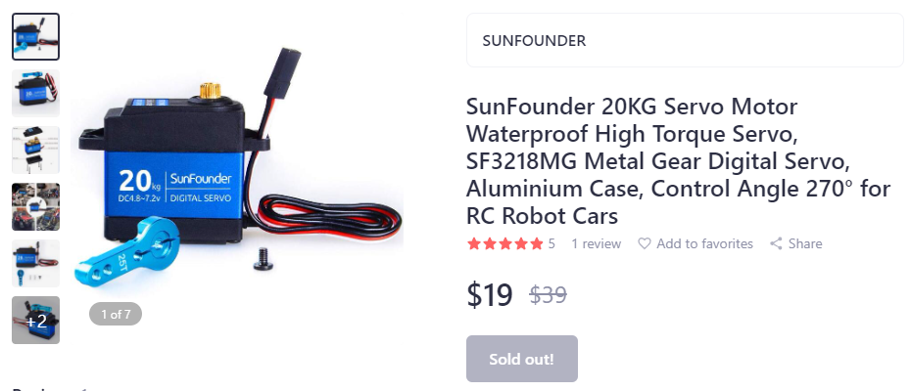
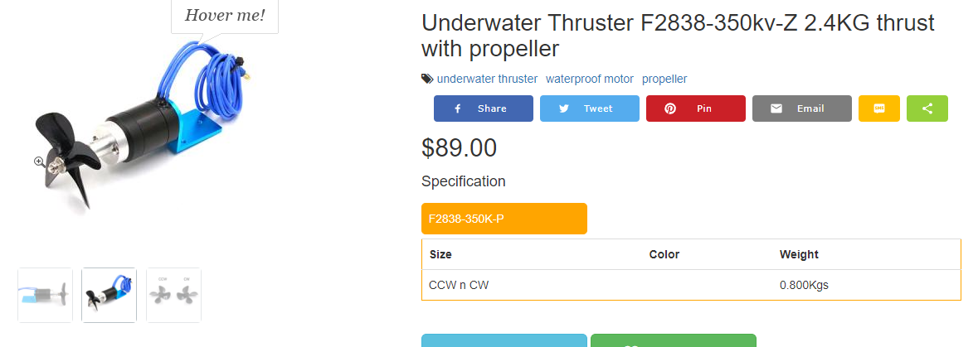
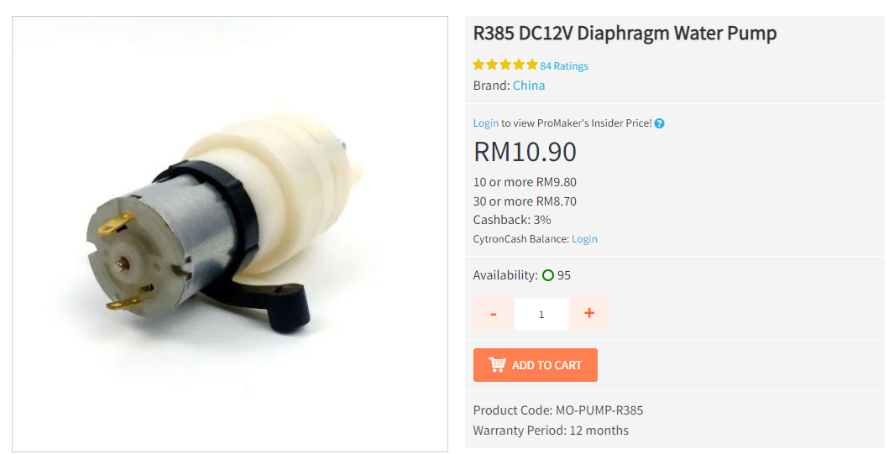
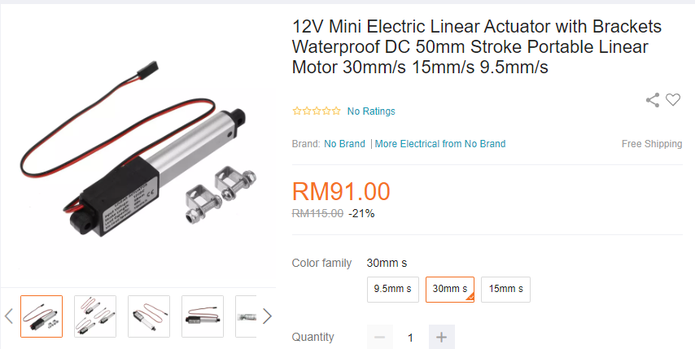
4) Swimming a) Fish robot

Slide 13
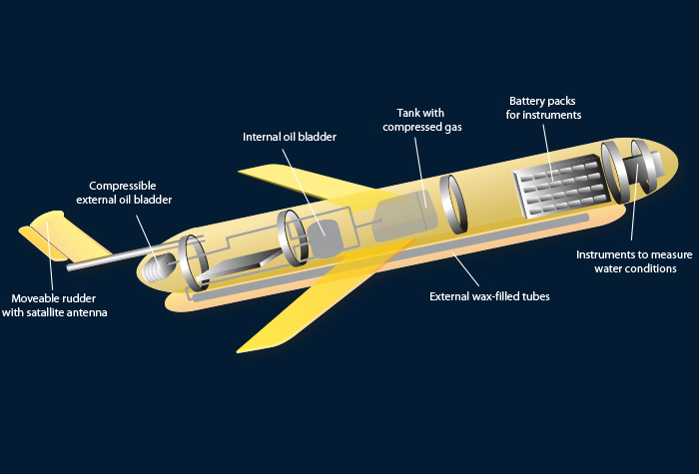
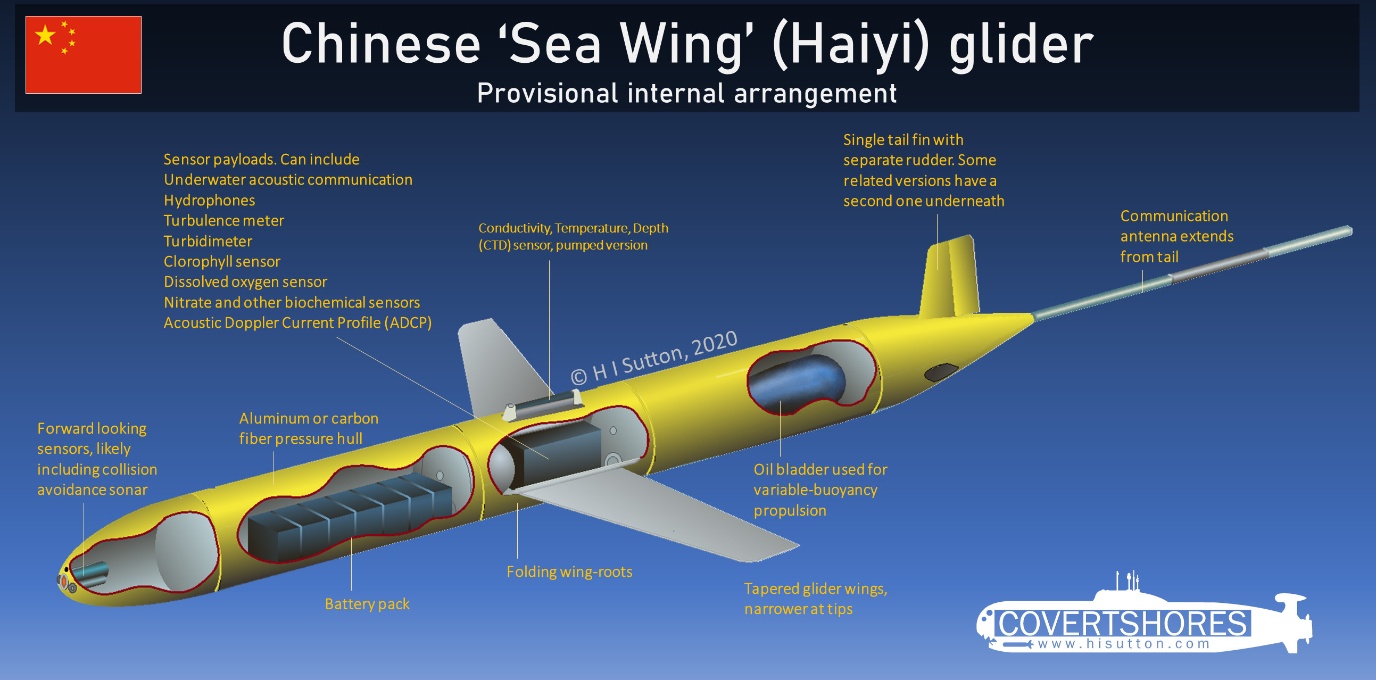
4) Swimming b) Underwater glider robot

Slide 14
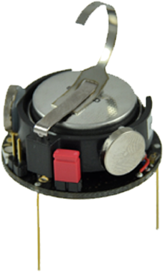
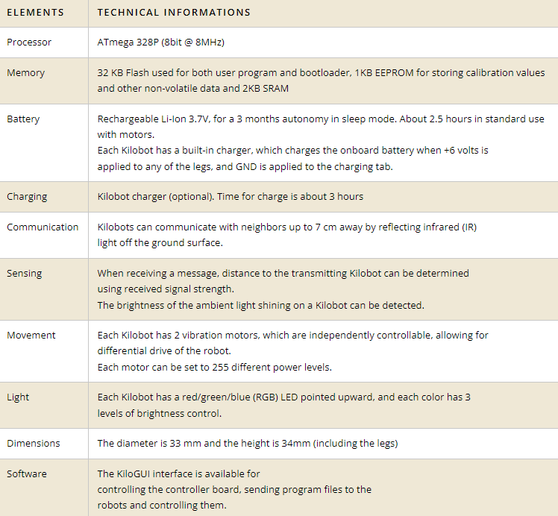
5) Others a) Kilobot

Slide 15
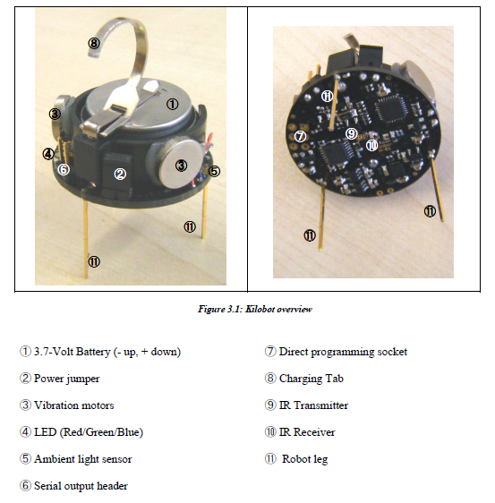
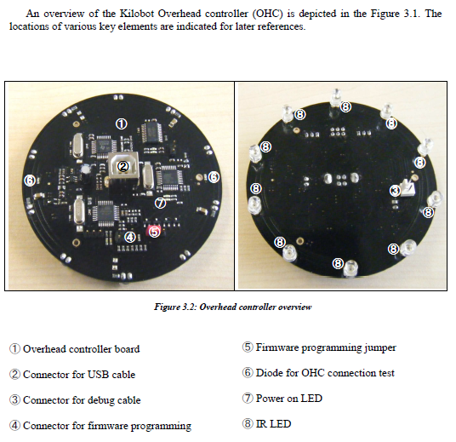
5) Others a) Kilobot

